Slide 1

Fraudulent Depop Listing Detection
Kylie Ren, Esther Choi, Kai Hu, Bofei Xu, Serena Bai

Slide 2
Table of contents
01
02
03
04
05
Introduction
Dataset
Model 1: Tree-based Models
Model 2: Neural Network
Results and Conclusions

Slide 3
01
Introduction

Slide 4

Background and Motivation
Fraudulent/”scam” users on e-commerce platforms like Depop are a growing problem
Key stakeholders
Sellers
Buyers
Depop
Our goal is to build a model to detect fraudulent listings so they can be reviewed and removed by Depop as soon as possible

Slide 5
Research Question: What features and models can be used to accurately classify Depop listings as real or fraudulent?

Slide 6
02
Dataset

Slide 7
Data Collection and Cleaning
Data Scraping
Manual Labelling
Data Cleaning and Engineering
Scrape list of users based on search term “Carhartt jacket” from Depop
Scrape listing and user details based on usernames
Manually go through each scraped user and classify as real user (0), scam user (1), or new user (2) based on judgement criteria
Verified by multiple group members
Convert listing descriptions to one hot encoded representation of 1000 most common words
Drop or replace missing values
Merge annotated data and scraped data

Slide 8
Exploratory Data Analysis
Interpretation of three type users
Ratio and count for each type
User’s type == product’s type
Main categories of brands, category and states

Slide 9

Labelling Users: Binary
Fake Users | Real Users
Zero seller reviews | Many seller reviews
Few or no sold products | Many sold products
Different backgrounds | Cohesive backgrounds
Suspicious pricing | Believable pricing
Unoriginal photos | Photos are their own
Fake Users
Real Users

Slide 10

Labelling Users: Binary
Fake Users | Real Users
Zero seller reviews | Many seller reviews
Few or no sold products | Many sold products
Different backgrounds | Cohesive backgrounds
Suspicious pricing | Believable pricing
Unoriginal photos | Photos are their own
Exhibit A:
Fake Users
Real Users

Slide 11
Labelling Users: Binary
Fake Users | Real Users
Zero seller reviews | Many seller reviews
Few or no sold products | Many sold products
Different backgrounds | Cohesive backgrounds
Suspicious pricing | Believable pricing
Unoriginal photos | Photos are their own
Exhibit A:
Fake Users
Real Users

Slide 12
Labelling Users: Binary
Fake Users | Real Users
Zero seller reviews | Many seller reviews
Few or no sold products | Many sold products
Different backgrounds | Cohesive backgrounds
Suspicious pricing | Believable pricing
Unoriginal photos | Photos are their own
Fake Users
Real Users

Slide 13
Labelling Sellers: Tertiary
Fake Sellers
Real Sellers

Slide 14
03
Tree-based models

Slide 15
Feature engineering
Drop columns with missing values
Drop columns with Unique values at all rows
Convert all features in to correct data type
One-hot encoding categorical features
Use Bag of Words feature
Merge all description into single string
Remove punctuations
Remove stop words
Select 1000 most common words as BOW features
70-30 Train test split
The combination of numerical, one-hot-encoded categorical and BOW features are used to train Tree-based Models.

Slide 16
3 Tree Models
Since our question is a classification problem with many variables, we first chose to use tree-based methods
Decision Tree
Random Forest
Gradient Boosting
& XGboost
Simplest tree model
Fastest model to build and run
Easy to interpret
Prone to overfitting
Ensemble method consisting of many decision trees
Reduces variance and chance of overfitting
Uses simple average of trees to get final result
Ensemble method of multiple trees that uses boosting
Adds to model one tree at a time, minimizing loss
More difficult to tune hyperparameters
Often performs better on unbalanced data
XGboost perform regularization.

Slide 17
Model results
Decision Tree
Random Forest
Gradient Boosting
 | 0 | 1 | 2
0 | 28075 | 6 | 39
1 | 0 | 1106 | 2
2 | 59 | 1 | 214
 | 0 | 1 | 2
0 | 28081 | 0 | 39
1 | 17 | 1088 | 3
2 | 71 | 0 | 203
 | 0 | 1 | 2
0 | 28091 | 7 | 22
1 | 0 | 1106 | 2
2 | 59 | 1 | 214
Accuracy = 0.99637
Recall = 1.00
Precision = 0.99
Accuracy = 0.99559
Recall = 0.98
Precision = 1.00
Accuracy = 0.99692
Recall = 1.00
Precision = 0.99

Slide 18
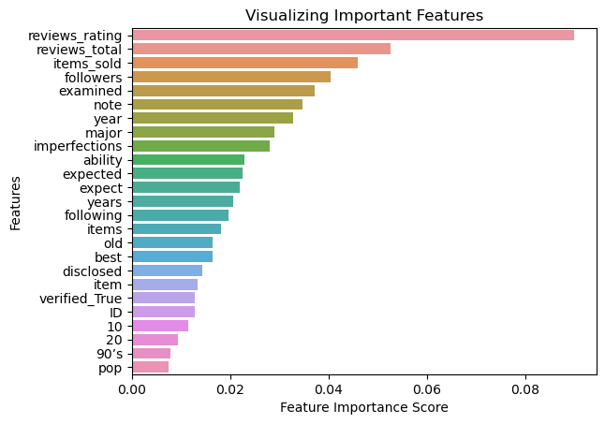
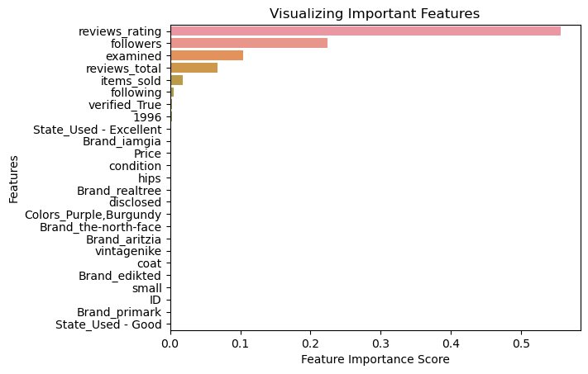
Feature Importance Plots
Random Forest
Gradient Boost

Slide 19
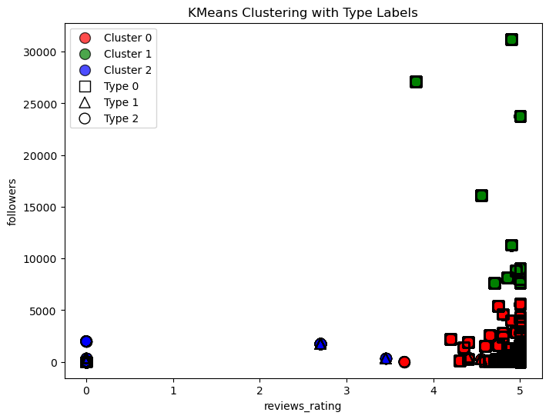
K-means Clustering on Review rating and Followers
Type Cluster | 0 | 1 | 2
0 | 0.98 | 0.02 | 0.01
1 | 1.00 | 0.00 | 0.00
2 | 0.02 | 0.79 | 0.18

Slide 20
04
Neural Network

Slide 21
Neural Network
Reasoning: The most important feature for tree methods was review_rating, followed by review_count, and item_sold. However, this is not helpful when classifying new users with no reviews.
Let’s try to build a model only based on the listing description.
Steps:
Embed the product description on a sentence/sequence level - RoBERTa - 768 dimensional numeric vector.
Train the NN for the multi-classification task, with only the sentence embedding as input variables
Evaluate the SentEmb NN’s performance
PCA on the internal representation of SentEmb NN, for Visualization
Notes:
pretrained all-distilroberta-v1 model, which is based on BERT (Bidirectional Encoder Representations from Transformers).

Slide 22
Modeling Details and Considerations
NN with dimensions [768, 512, 512, 512, 256, 256, 3] ,
One linear layer, followed by non-linear layers with ReLU as their activation function
The dataset were split into the training set and a validation set by a 0.8/0.2 ratio.
The Cross Entropy loss function was considered.
Adam was selected as the optimizer.
The class imbalance was addressed by implementing class weights in evaluating the loss.
An early stopping criterion of “No improvement of validation loss over 20 epochs” was selected.

Slide 23
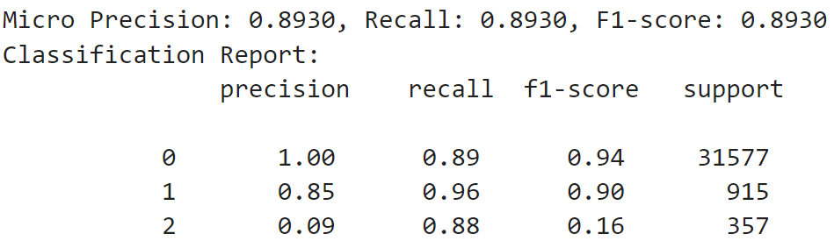
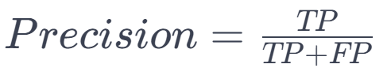
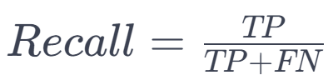
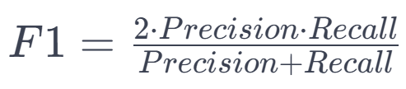
Results (on validation set)
Notes:
Precision:
Precision is the ratio of true positives to the sum of true positives and false positives.
It measures the accuracy of the positive predictions, indicating how many of the predicted positive instances were actually positive.
Recall (Sensitivity or True Positive Rate):
Recall is the ratio of true positives to the sum of true positives and false negatives.
It measures the ability of the model to capture all the relevant instances, indicating
F1-Score:
F1-score is the harmonic mean of precision and recall.
It provides a balanced measure between precision and recall, especially useful when the class distribution is imbalanced.
Support:
Support is the number of actual occurrences of the class in the specified dataset.
It represents the number of true instances for each class and is useful for understanding the distribution of classes in the dataset.

Slide 24
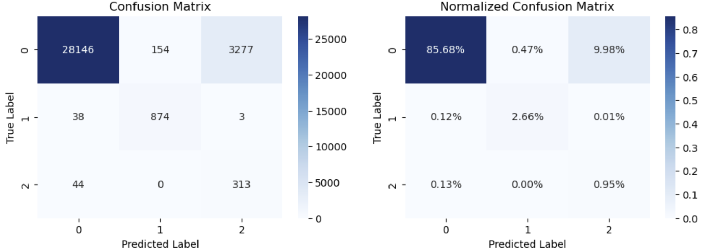
Results (on validation set)
Notes:
While a considerable number of Class 0 users were misclassified as the other two classes by this model, this task could have been easily handled by a tree-based model and were not the focus of the SentEmb NN model.

Slide 25
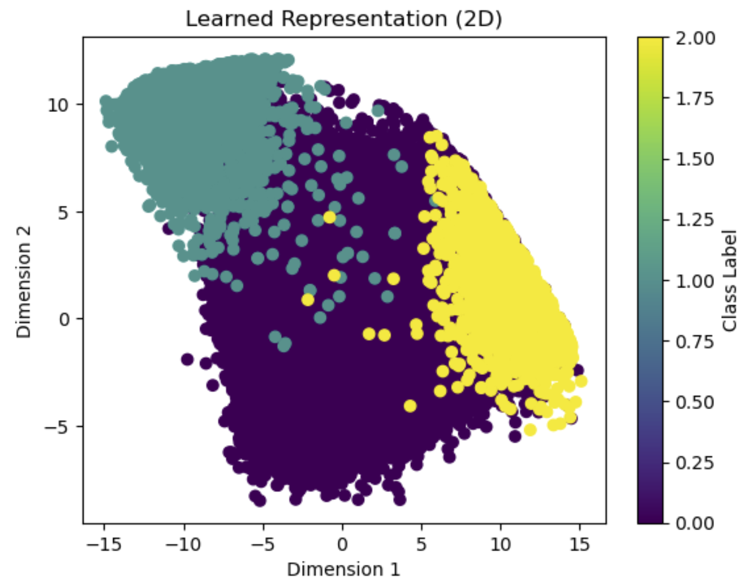
Results (on validation set)
Notes:
One drawback of NNs is the low interpretability of their self-extracted “features”. To interpret the model’s internal representations, I performed PCA on the hidden vector before the output layer, and plotted the data points with the X-axis as the first principal component, with the Y-axis as the second principal component.
This result is very encouraging as the separation between Class 1 (by fake users), and Class 2 (by new users) listings are very clear. Together with the results shown in the confusion matrix, we determined that the SentEmb NN model was able to differentiate between these two target classes very well. While a considerable number of Class 0 users were misclassified as the other two classes by this model, this task could have been easily handled by a tree-based model and were not the focus of the SentEmb NN model.
This is particularly meaningful in differentiating the new sellers from the fake sellers, who could both have a 0 review, a few to none followers, and haven’t sold many items.

Slide 26
05
Results and Conclusions

Slide 27
Tree Based Models
All three models achieved very high accuracy, precision, and recall
XGboost and Gradient Boosting take significantly more time to run (cannot take advantage of parallelization)
Overall, Decision Tree and Random Forest were good choices of model, both having reviews_rating as most important feature, followed by reviews_total and items_sold

Slide 28
Neural Network
Only using ‘Description’ (pure textual data) to classify.
Clear distinction between clusters of the validation results, indicating the NN capture the information between different types of products.
SentEmb Neural Net model promising solution for distinguishing between new and fake users.

Slide 29
Implications and Next Steps
Promising model, but needs further development before being used in real world
Model flaws
Data collection process introduces bias into dataset
Limited computing power meant small data sample size
Labelled data by seller instead of by product
Data scraping limited to one search result
Improvements
Vastly increase sample size
Develop a better process for labelling data that reduces labeller bias
Incorporate listing images into model using computer vision

Slide 30
Questions

